Slide 1
Neural Networks and Deep Learning (18CSE23)
(B.E (CSE) VII-Sem PE-V)
Unit-III Part-2 Presentation on
Autoencoders, Regularization
By
Dr. Kolla Morarjee
Associate Professor, Department of CSE
Chaitanya Bharathi Institute of Technology, Hyderabad

Slide 2
Autoencoders
Relation to PCA
Regularization in auto encoders
Denoising auto encoders
Sparse auto encoders
Contractive auto encoders
Regularization
Bias Variance Tradeoff
L2 regularization
Early stopping
Dataset augmentation
Parameter sharing and tying
Injecting noise at input
Ensemble methods
Dropout, Greedy Layer wise Pre-training
Better activation functions
Better weight initialization methods
Batch Normalisation

Slide 3
Structure of an Autoencoder
Hidden layer (code)
h
f
g
Input
Reconstruction
(Goodfellow 2016)

Slide 4
Stochastic Autoencoders
h
pencoder(h | x) pdecoder(x | h)
(Goodfellow 2016)

Slide 5
Avoiding Trivial Identity
Undercomplete autoencoders
  h has lower dimension than x
  f or g has low capacity (e.g., linear g)
  Must discard some information in h
Overcomplete autoencoders
  h has higher dimension than x
  Must be regularized
(Goodfellow 2016)

Slide 6
Regularized Autoencoders
Sparse autoencoders
Denoising autoencoders
Autoencoders with dropout on the hidden layer
Contractive autoencoders
(Goodfellow 2016)

Slide 7
Sparse Autoencoders
Limit capacity of autoencoder by adding a term to the cost function penalizing the code for being larger
Special case of variational autoencoder
  Probabilistic model
  Laplace prior corresponds to L1 sparsity penalty
  Dirac variational posterior
(Goodfellow 2016)

Slide 8
Denoising Autoencoder
h
g
f
C: corruption process
x˜
L
(introduce noise)
C(x˜ | x)
L = — log p
decoder
(x | h = f (x˜))
(Goodfellow 2016)

Slide 9


Denoising Autoencoders Learn a Manifold
x˜
g ◦ f
x˜
C(x˜ | x)
(Goodfellow 2016)

Slide 10
Score Matching
Score: _{x} log p(x).
Fit a density model by matching score of model to score of data
Some denoising autoencoders are equivalent to score matching applied to some density models
(Goodfellow 2016)

Slide 11
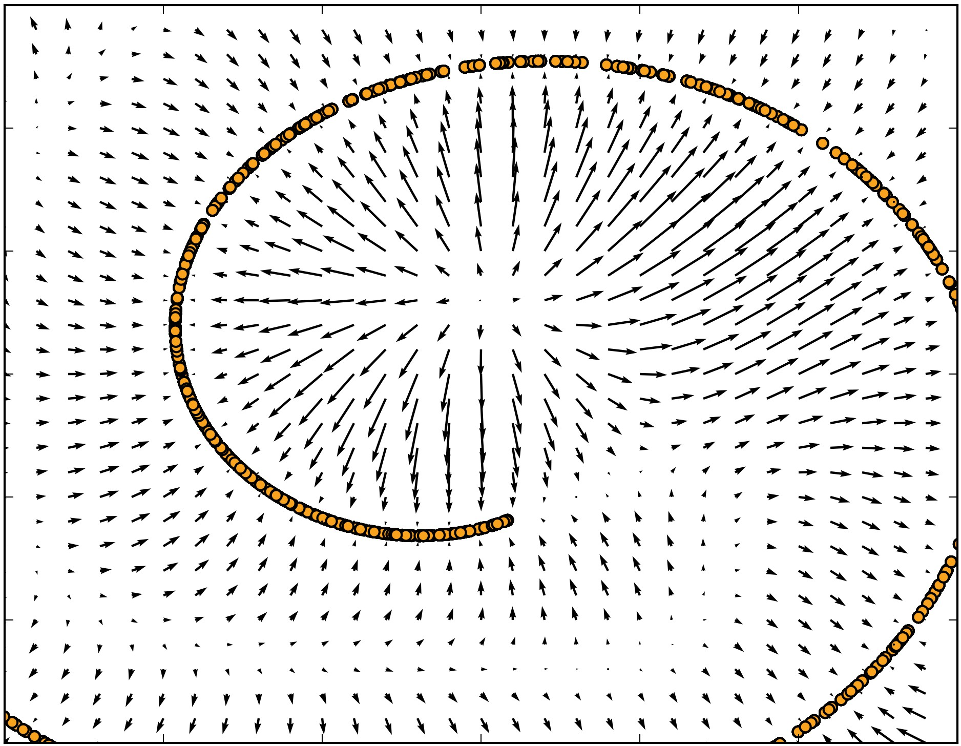
Vector Field Learned by a Denoising Autoencoder
(Goodfellow 2016)

Slide 12


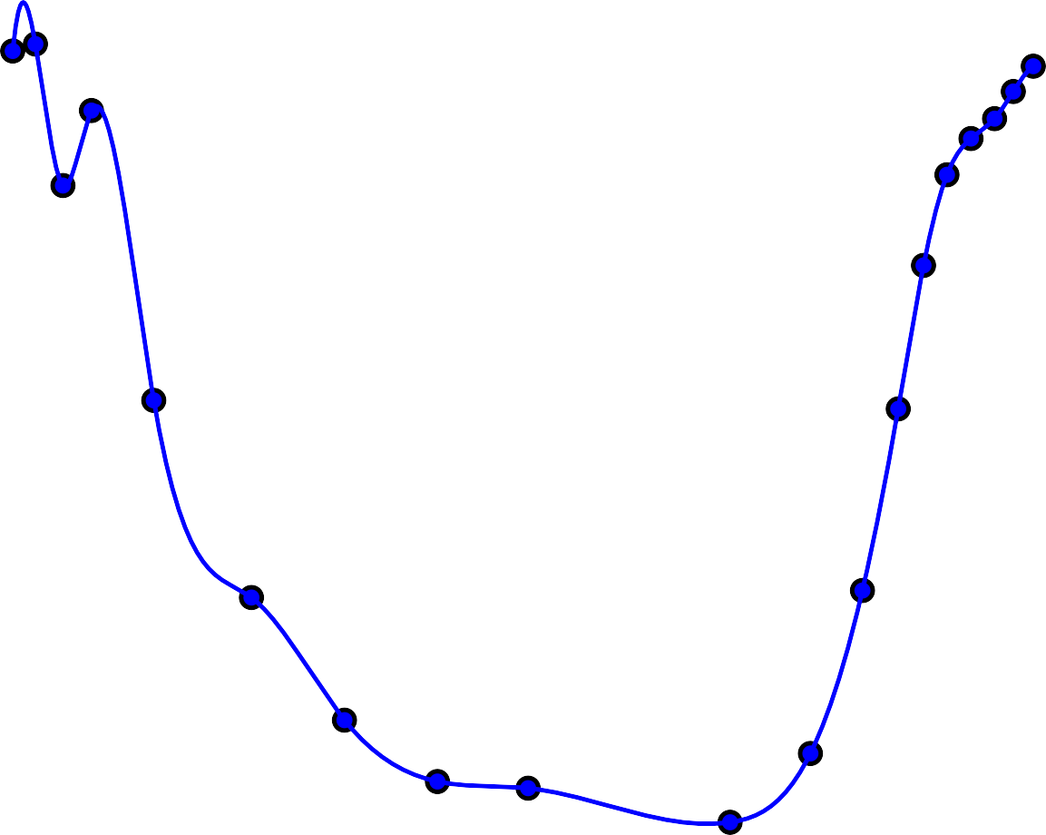







Tangent Hyperplane of a Manifold
(Goodfellow 2016)

Slide 13

Learning a Collection of 0-D Manifolds by Resisting Perturbation
1.0
Identity
Optimal reconstruction
0.8
0.6
0.4
0.2
0.0
x₀
x₂
(Goodfellow 2016)

Slide 14









Non-Parametric Manifold Learning with Nearest-Neighbor Graphs
(Goodfellow 2016)

Slide 15
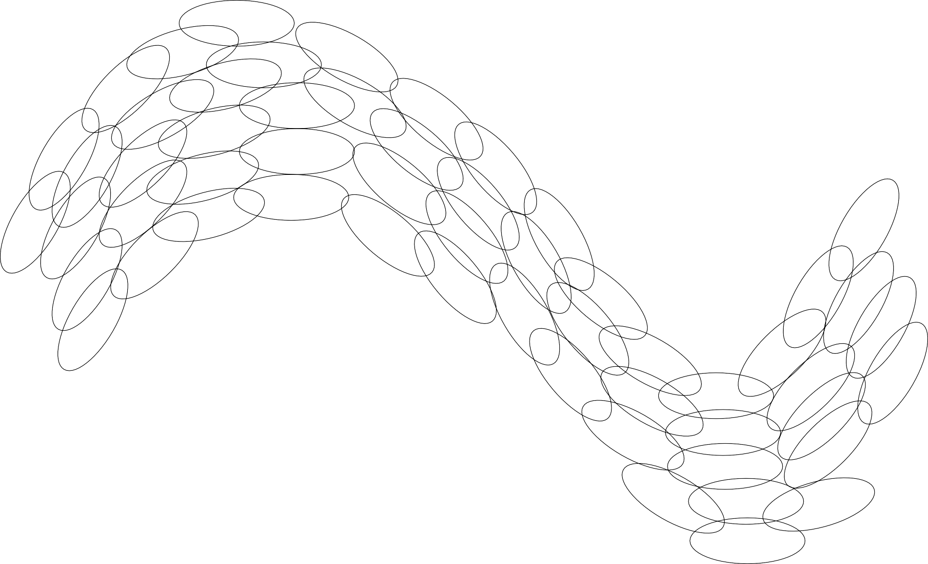
Tiling a Manifold with Local Coordinate Systems
(Goodfellow 2016)

Slide 16
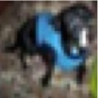
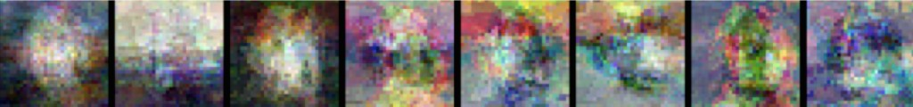
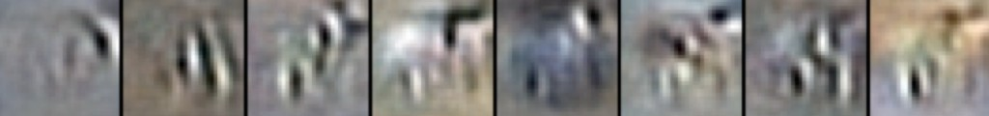
Contractive Autoencoders
@f(x)
@x
2
⌦(h) = λ
¨
¨
.
¨
¨
F
Input point
Tangent vectors
Local PCA (no sharing across regions)
Contractive autoencoder
(Goodfellow 2016)

Slide 17
Human Learning Evaluation
Regularization
Bias Variance Tradeoff
Teacher explains logic with some problem, how can we test whether a student grab the logic or not?
Goal: The logic should be tested such a way that (s)he could solve any new variation of that problem in future.
Which aspects of learning we wish to evaluate?
Bias & Variance of learning

Slide 18
Human Learning Evaluation
What aspects of learning teacher wishes to test?
– Bias: How accurately (s)he can solve different variations of problem. In other words, the extent to which his/her averaged accuracy differs from expected accuracy
– Variance: | How | much | consistent in his/her
capability | of | solving | those variations of
problem

Slide 19
Machine Learning(Model) Evaluation
How do you evaluated machine learned model?
Goal: Select the model that best performs on unseen(future) data.
Which aspects of learning evaluate?
Bias & Variance of model
we wish to

Slide 20
Parameter Tuning

Slide 21
Parameter Tuning Problem
Which parameter values do you select for given model?
Goal: Select the parameters of model that provides best performance on unseen(future) data.

Slide 22
Parameter Tuning Algorithm
Define sets of model parameter values to evaluate
For each parameter set do
– Estimate the average error/accuracy of model using chosen resampling technique
Choose the parameters that gives smallest error or highest accuracy, and build the model on entire data with the chosen parameters.

Slide 23
Model Selection

Slide 24
Model Selection Problem
If you have multiple models, which model do you select for deployment?
Goal: Select the model that best performs on unseen(future) data.

Slide 25
Model Selection Algorithm
Define the bunch of models we wish to evaluate
For each model do
– Estimate the average error/accuracy of model using chosen resampling technique
Choose the model that gives smallest error or highest accuracy.

Slide 26
Model Selection Problem
Predictive Error
Error on Validation Data
Error on Training Data
Model Complexity

Slide 27
Model Selection Problem
Not able to capture relevant patterns
Underfitting(High bias, low variance)
Predictive Error
May be capturing irrelevant patterns
Overfitting(Low bias, high variance)
Error on Validation Data
Error on Training Data
Model Complexity
Ideal Range
for Model Complexity
Simpler Models predictions.
are not able to capture relevant patterns and might have too big of a bias in
Complex Models may “chase” irrelevant patterns in the training data that are not likely to exist in future data.

Slide 28
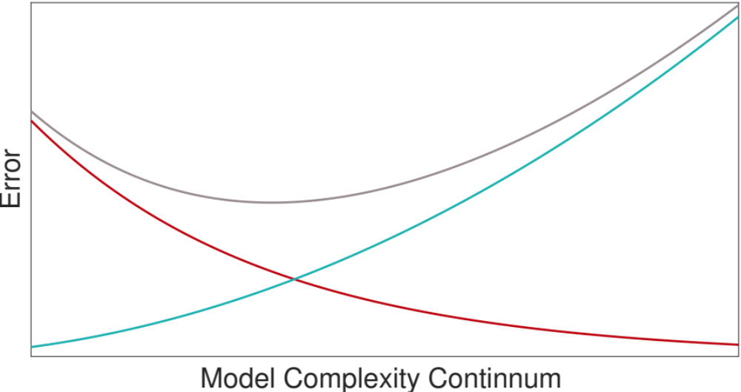
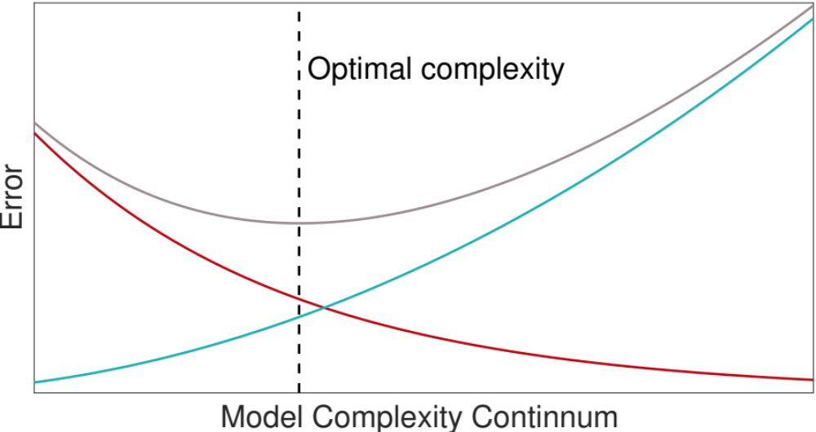
Bias-Variance Trade Off
MSE
variance
bias²
Notes:
MSE is high on left because bias^2 is high
MSE is high on right because variance is high
[*] optimal complexity

Slide 29
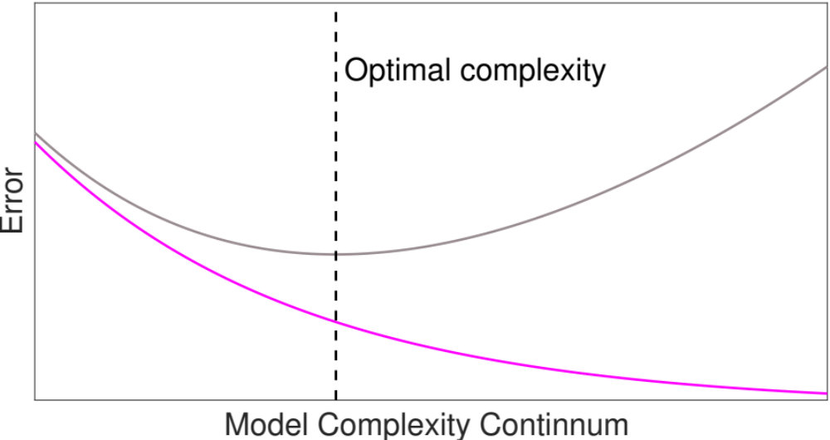
Bias-Variance Trade Off Is Revealed Via Test Set Not Training Set
MSE_{test}
MSE_{train}
Notes:
early stopping and deep nets bengio ICLR
batch norm
understanding deep learning rethinking generalizationf
kushner H Weak confergence methods and singularly perturbed stochastic control and filtering problems
Borkar – stochastic approximation with two time scales
l.dickens@ucl.ac.uk

Slide 30
Bias Variance Tradeoff
L2 regularization
Early stopping
Ensemble methods
Dropout
Batch Normalisation
https://www.slideshare.net/KienLe47/regularization-in-deep-learning
https://www.analyticsvidhya.com/blog/2021/03/introduction-to-batch-normalization/
https://towardsdatascience.com/ensemble-methods-in-machine-learning-what-are-they-and-why-use-them-68ec3f9fef5f

Slide 31
Regularization for Deep Learning
“Regularization is any modification we make to a learning algorithm that is intended to reduce its generalization error but not its training error.”

Slide 32





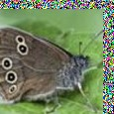

Dataset Augmentation
Aﬃne Distortion
Elastic Deformation
Noise
Horizontal flip
Random Translation
Hue Shift
(Goodfellow 2016)

Slide 33
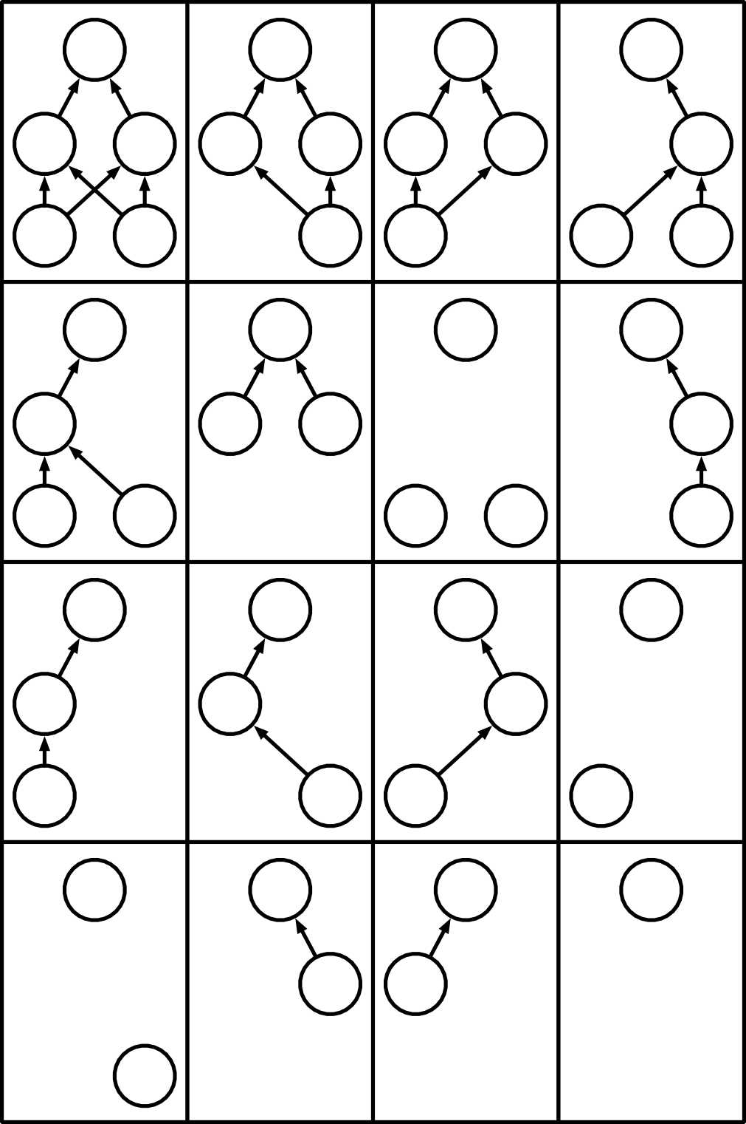






Dropout
y y
y
y
h₁
h₂ h₁
h₂ h₁
h₂
h₂
x₁
x₂
x₂ x₁
x₁
x₂
y
y
y
y
y
h₁
h₁
h₂
h₂
h₁
h₂
x₁
x₂
x₁
x₂
x₂
y
y
y
y
x₁
x₂
h₁
h₁
h₂
Base network
x₁
x₂ x₁
x₁
y
y
y
y
h₂ h₁
x₂
Ensemble of subnetworks

Slide 34
Parameter sharing and tying
Injecting noise at input
Greedy Layer wise Pre-training
Better activation functions
Better weight initialization methods
https://slideplayer.com/slide/15214134/
https://towardsdatascience.com/how-to-use-noise-to-your-advantage-5301071d9dc3
https://cedar.buffalo.edu/~srihari/CSE676/15.1%20Greedy-Layerwise.pdf
https://www.analyticsvidhya.com/blog/2020/01/fundamentals-deep-learning-activation-functions-when-to-use-them/
https://towardsdatascience.com/weight-initialization-techniques-in-neural-networks-26c649eb3b78

